Slide 1
AIMS: Automated Immune Molecule Separator
Chris Boughter
Adams and Roux Labs
Software Documentation 09/12/20
Notes:
VBPAAIM?... No

Slide 2
A Bioinformatic Workflow for Automated Immune Molecule Analysis
Hello and welcome to AIMS
The goal for this walkthrough will be to explain the features as we go through. Hopefully after this you’ll understand the basics enough to tweak some of the settings and try your own molecules!
For this first run-through I recommend users just try to replicate my results by following the steps outlined here exactly.
Good luck!
Notes:
Use this time to bring up the concepts of Shannon entropy and mutual information…
Talk just about the practical examples, but keep it in the space of amino acids.

Slide 3
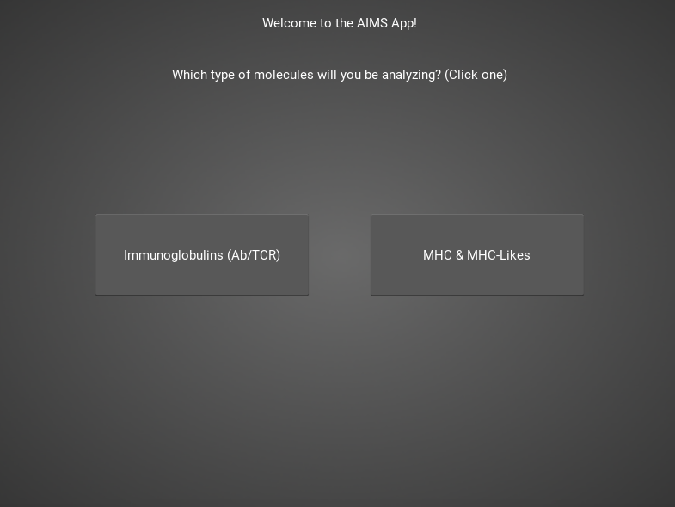
Welcome Screen: Choose Your Path
The software can analyze both Ig molecules and MHC-like molecules
We will run through the Ig analysis first. For MHC-like analysis go to slide 21
NOTE: Returning to this page after starting will delete all progress
Notes:
Use this time to bring up the concepts of Shannon entropy and mutual information…
Talk just about the practical examples, but keep it in the space of amino acids.

Slide 4
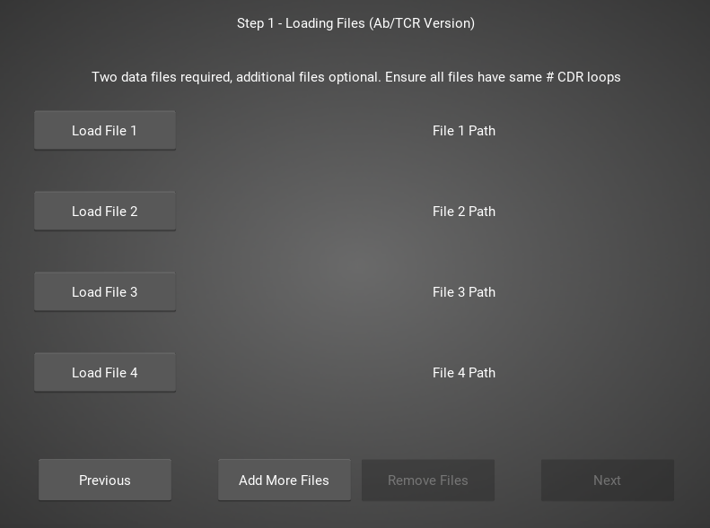
Step 1: Load in FASTA Files
This should be the first screen you see
FASTA files should be aligned sequences, with a minimum of 2 sequences per file, and a minimum of 2 FASTA files per program run
See ab_testData/ flu_poly.csv for formatting example
Notes:
Use this time to bring up the concepts of Shannon entropy and mutual information…
Talk just about the practical examples, but keep it in the space of amino acids.

Slide 5
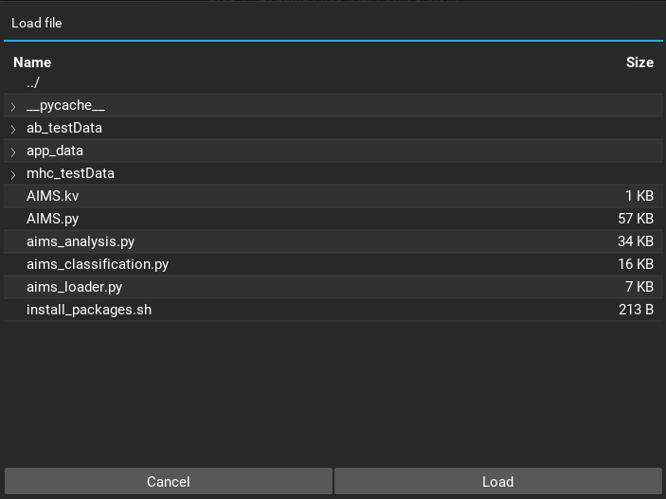
Step 1: Load in FASTA Files
Once you click one of those dark gray “load” buttons, you should get a screen that looks like this
Click on “ab_testData”
Notes:
Use this time to bring up the concepts of Shannon entropy and mutual information…
Talk just about the practical examples, but keep it in the space of amino acids.

Slide 6
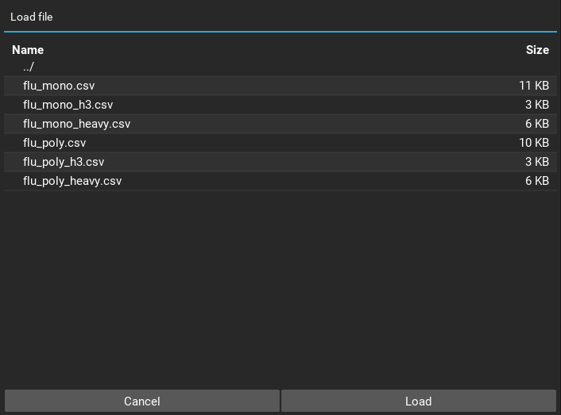
Step 1: Load in FASTA Files
That should bring you to this screen, where we have some sample FASTA files
Highlight the file you want to load, then click the “load” button
FASTA 1 should be “flu_mono.csv”
Notes:
Use this time to bring up the concepts of Shannon entropy and mutual information…
Talk just about the practical examples, but keep it in the space of amino acids.

Slide 7
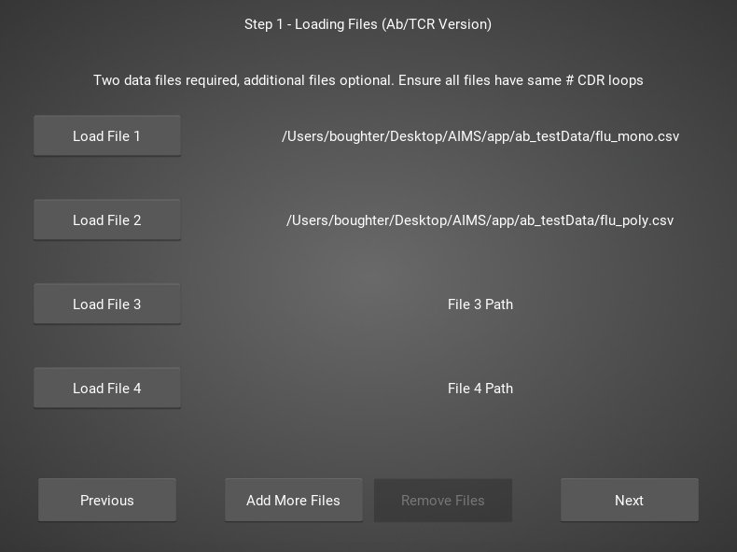
Step 1: Load in FASTA Files
To replicate my results exactly, make sure you load the FASTA files in this order
Obviously the first part of your path will be different from mine, just make sure the last section matches
Notes:
Use this time to bring up the concepts of Shannon entropy and mutual information…
Talk just about the practical examples, but keep it in the space of amino acids.

Slide 8
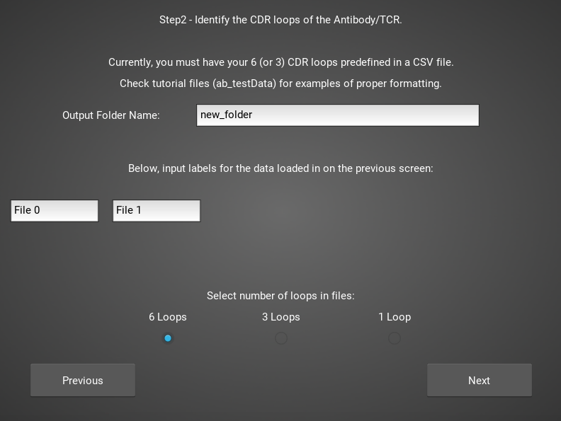
Step 2: Define Names and Outputs
On this page, we define the folder outputs are saved to
Below, we can change label names for each file loaded
Lastly, you must specify how many loops are in the files loaded in step1.
Notes:
Use this time to bring up the concepts of Shannon entropy and mutual information…
Talk just about the practical examples, but keep it in the space of amino acids.

Slide 9
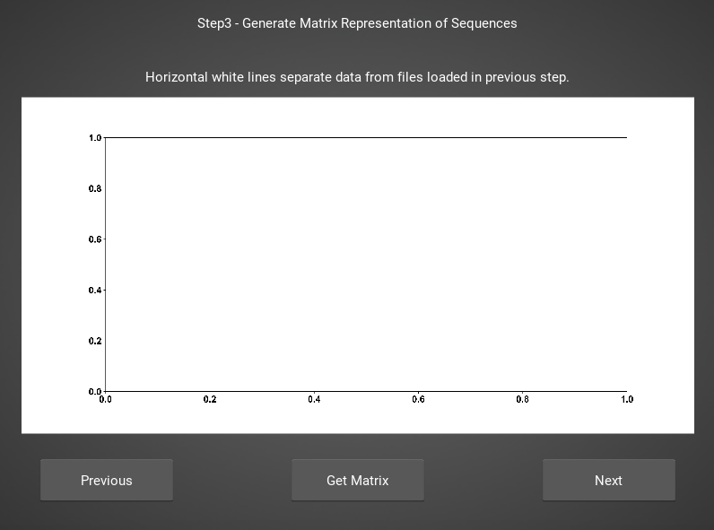
Step 3: Generate the Sequence Matrix
On this window, you can just click “get matrix” to generate the matrix for this step
This matrix must be generated for subsequent steps to function properly
Notes:
Use this time to bring up the concepts of Shannon entropy and mutual information…
Talk just about the practical examples, but keep it in the space of amino acids.

Slide 10
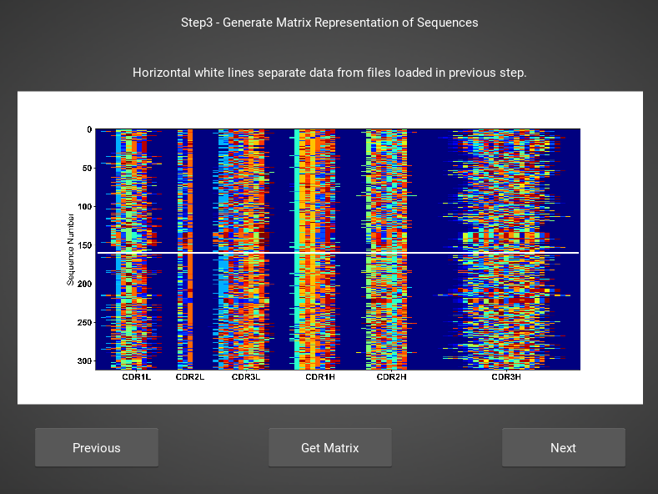
Step 3: Generate the Sequence Matrix
Congrats! You’ve generated your first piece of data using this software
You might notice that your image quality is poor for figures shown in the app
This is because the software shows *png files
Don’t worry, both versions of the plot are saved in whichever directory you specified in Step 2
Notes:
Use this time to bring up the concepts of Shannon entropy and mutual information…
Talk just about the practical examples, but keep it in the space of amino acids.

Slide 11
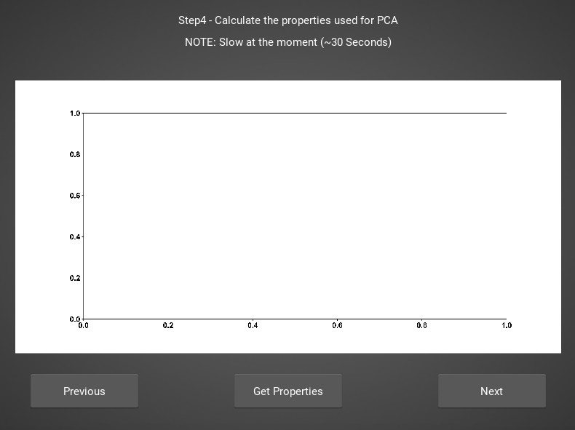
Step 4: Calculate Biophysical Properties
Again, we simply press the “get properties” button
If a matrix was not generated in the previous window, then this step will fail
Don’t worry if this step takes a little while, especially for bigger data. The code needs a little work, but is accurate
Notes:
Use this time to bring up the concepts of Shannon entropy and mutual information…
Talk just about the practical examples, but keep it in the space of amino acids.

Slide 12
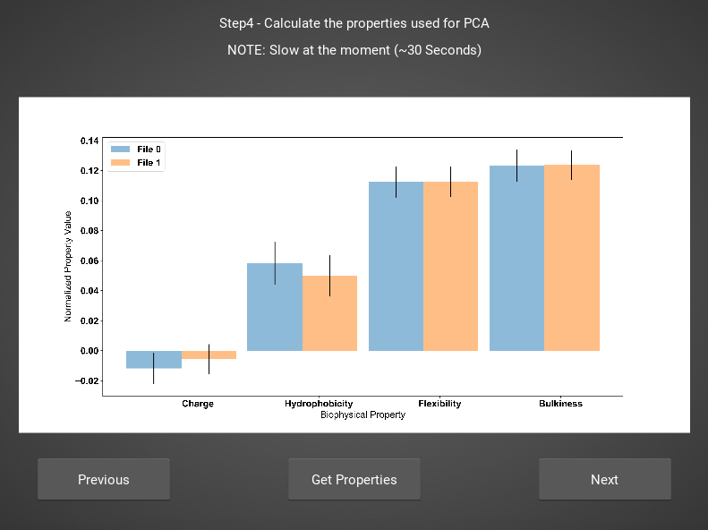
Step 4: Calculate Biophysical Properties
Again, if you’re following along, you should see this exact plot once the calculation finishes
Plotted are average and standard deviations of these normalized biophysical properties.
Each sequence has one value for each of these properties. i.e. flu_poly_sequence1 has charge = -0.01, hydrophobicity = 0.05, etc. (values made up)
Notes:
Use this time to bring up the concepts of Shannon entropy and mutual information…
Talk just about the practical examples, but keep it in the space of amino acids.

Slide 13
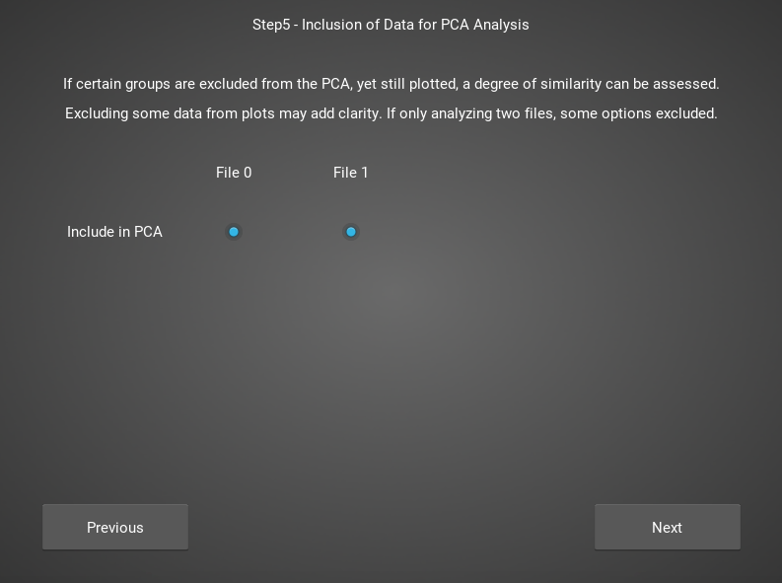
Step 5: Define Which Files to Group and Plot
In this step, you can really take some freedoms and play around.
What we are doing here is telling the software which groups we want to feed into the PCA analysis
Then, in the ”Plotted Group” section, we are letting the software know which groups will be shown on the resultant plot. Even if a group was used in the analysis, it doesn’t need to be plotted (and vice versa)
NOTE: No options are given if only comparing two datasets. See MHC example for possibilities when there are three or more datasets.
Notes:
Use this time to bring up the concepts of Shannon entropy and mutual information…
Talk just about the practical examples, but keep it in the space of amino acids.

Slide 14
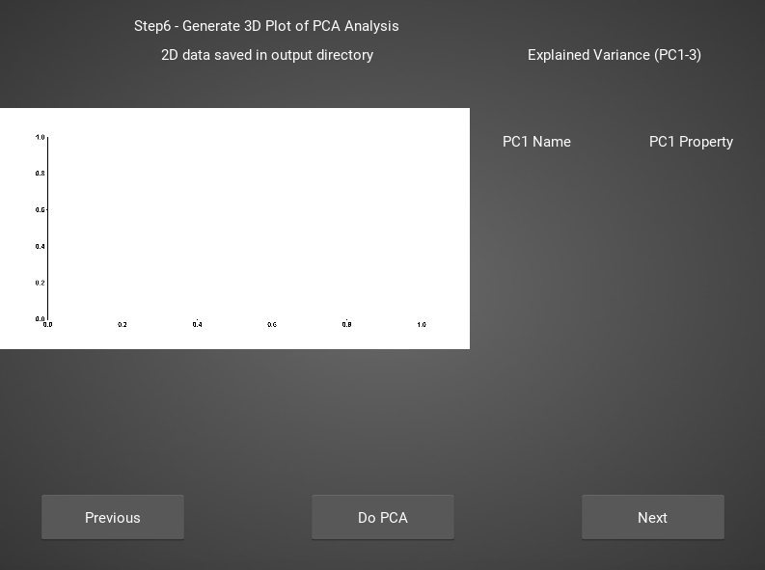
Step 6: Run and Plot PCA
On this screen, we take the properties form step 4 and run a PCA on them
If you choose to exclude certain data from the PCA, but still plot it, then you are simply projecting that data onto the calculated principal component.
Notes:
Use this time to bring up the concepts of Shannon entropy and mutual information…
Talk just about the practical examples, but keep it in the space of amino acids.

Slide 15
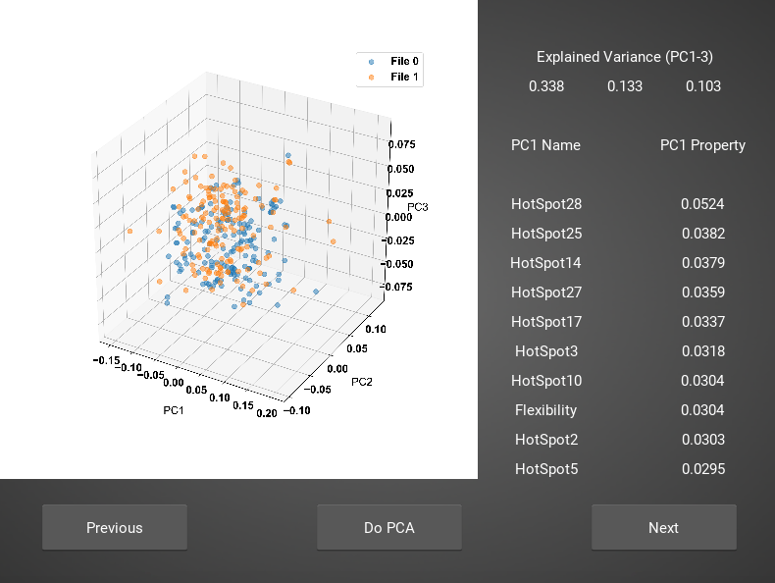
Step 6: Run and Plot PCA
Along with a plot of the first 3 PCs, we also report the explained variance of these PCs, and the top 10 weights that make up PC1.
A 2D plot is also included in the saved figures.
Notes:
Use this time to bring up the concepts of Shannon entropy and mutual information…
Talk just about the practical examples, but keep it in the space of amino acids.

Slide 16
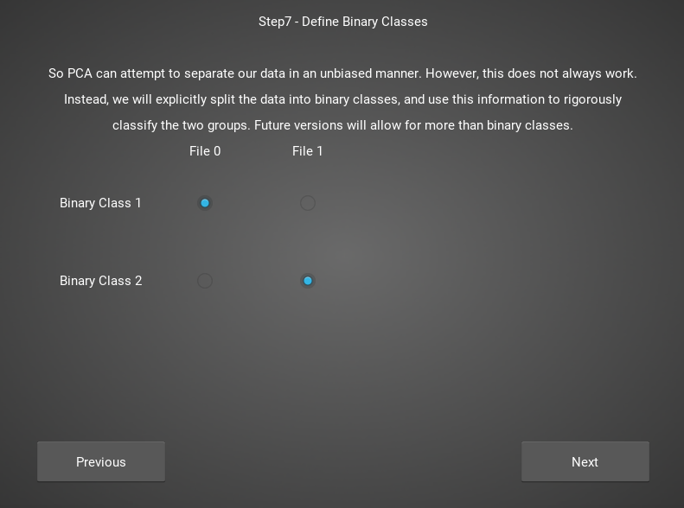
Step 7: Define Binary Classes
Here, we separate our loaded data into binary classes for some machine-learning based analysis.
Once again, there are fewer options here when comparing 2 files. See MHC step7 for what it looks like with more options
Notes:
Use this time to bring up the concepts of Shannon entropy and mutual information…
Talk just about the practical examples, but keep it in the space of amino acids.

Slide 17
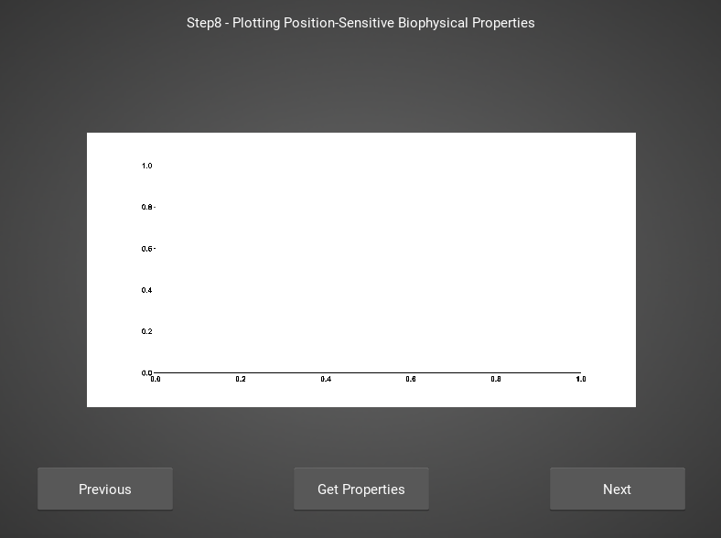
Step 8: Get Position Sensitive Biophysical Properties of Classes
Whereas the biophysical properties of step 4 are averaged across entire molecules, we can instead average across our full molecular population
By doing so, we can look at average biophysical properties as a function of sequence space, part of our special “positional encoding”
Notes:
Use this time to bring up the concepts of Shannon entropy and mutual information…
Talk just about the practical examples, but keep it in the space of amino acids.

Slide 18
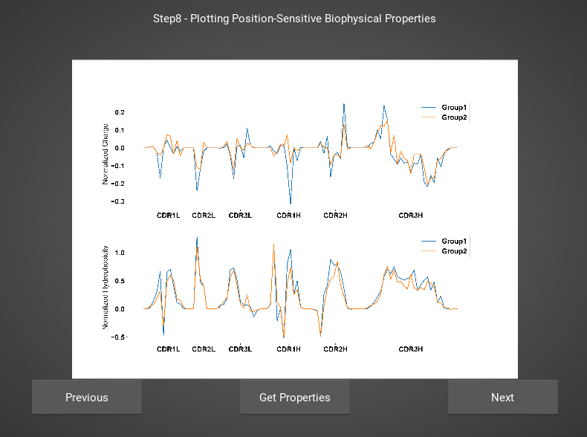
Step 8: Get Position Sensitive Biophysical Properties of Classes
We only show charge and hydrophobicity, but position sensitive data for all 62 properties are saved in the same directory as pdf figures.
NOTE: Standard deviations are not shown, and ideally these would be calculated via bootstrapping
Notes:
Use this time to bring up the concepts of Shannon entropy and mutual information…
Talk just about the practical examples, but keep it in the space of amino acids.

Slide 19
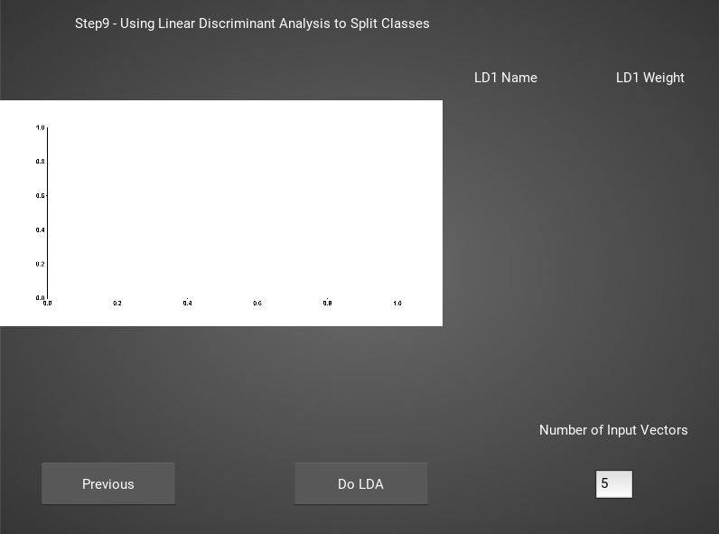
Step 9: Linear Discriminant Analysis
Unlike PCA, linear discriminant analysis (LDA) is designed to split binary classes of data
Effectively, we can use it to find where the strongest differences in the data are
However, care must be taken not to overfit. If # Input Vectors is greater than the size of one of your datasets, you will overfit the data
Notes:
Use this time to bring up the concepts of Shannon entropy and mutual information…
Talk just about the practical examples, but keep it in the space of amino acids.

Slide 20
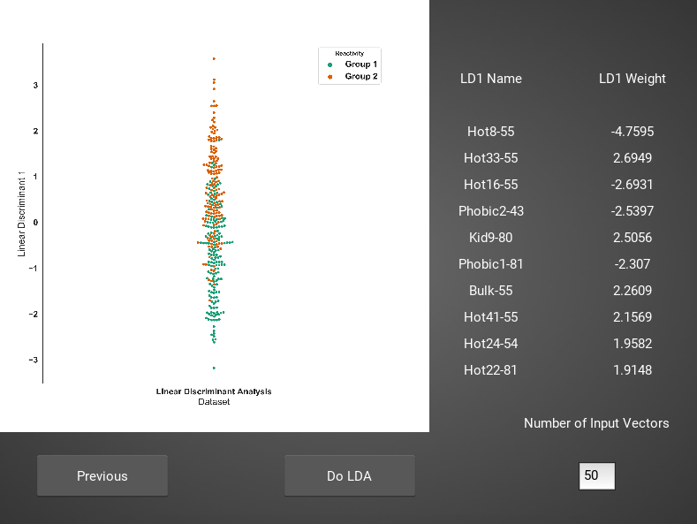
Step 9: Linear Discriminant Analysis
For this example data, if we use 50 input vectors, we obtain a decent splitting of the data
The LD1 “names” and “weights” refer to the top ten weights that most strongly split the data
In other words, LDA tells you where the biggest differences are, positionally, in your dataset
Notes:
Use this time to bring up the concepts of Shannon entropy and mutual information…
Talk just about the practical examples, but keep it in the space of amino acids.

Slide 21
MHC Analysis
Notes:
Use this time to bring up the concepts of Shannon entropy and mutual information…
Talk just about the practical examples, but keep it in the space of amino acids.

Slide 22
Step 1: Load in FASTA Files
This should be the first screen you see
FASTA files should be aligned sequences, with a minimum of 2 sequences per file, and a minimum of 2 FASTA files per program run
For the MHCs, formatting should just be in normal FASTA format
Notes:
Use this time to bring up the concepts of Shannon entropy and mutual information…
Talk just about the practical examples, but keep it in the space of amino acids.

Slide 23
Step 1: Load in FASTA Files
Once you click one of those dark gray “load” buttons, you should get a screen that looks like this
Click on “mhc_testData”
Notes:
Use this time to bring up the concepts of Shannon entropy and mutual information…
Talk just about the practical examples, but keep it in the space of amino acids.

Slide 24
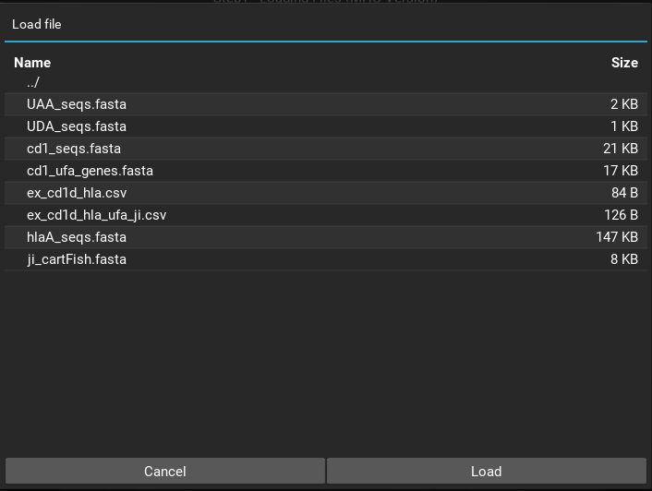
Step 1: Load in FASTA Files
That should bring you to this screen, where we have some sample FASTA files
Highlight the file you want to load, then click the “load” button
FASTA 1 should be “cd1_seqs.fasta”
Notes:
Use this time to bring up the concepts of Shannon entropy and mutual information…
Talk just about the practical examples, but keep it in the space of amino acids.

Slide 25
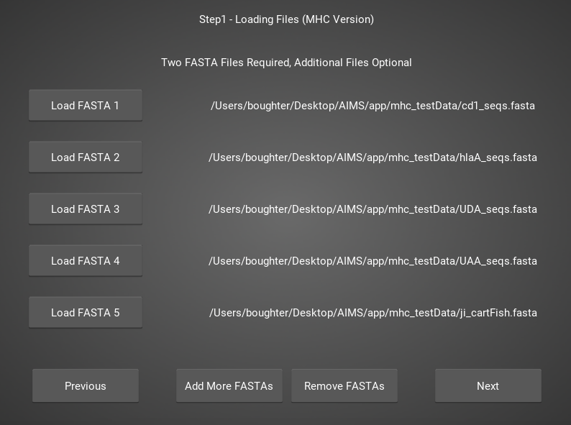
Step 1: Load in FASTA Files
To replicate my results exactly, make sure you load the FASTA files in this order
Obviously the first part of your path will be different from mine, just make sure the last section matches
Notes:
Use this time to bring up the concepts of Shannon entropy and mutual information…
Talk just about the practical examples, but keep it in the space of amino acids.

Slide 26
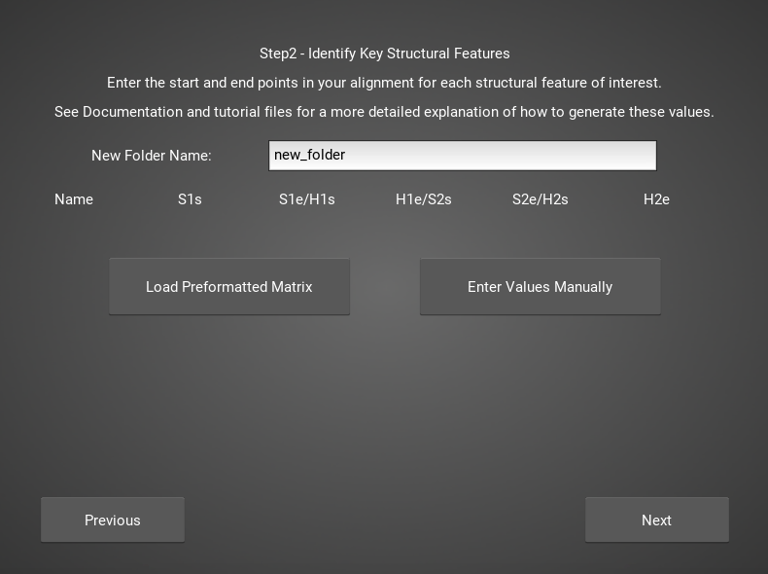
Step 2: Locate Helices and Strands
So this is my least favorite part of the software, but it turns out this is the most efficient way to do things
Here, we explicitly say where in the alignments the strands/helices start
In an attempt to make this slightly less annoying, I’ve made it possible to create pre-formatted matrices for repeated analysis
Notes:
Use this time to bring up the concepts of Shannon entropy and mutual information…
Talk just about the practical examples, but keep it in the space of amino acids.

Slide 27
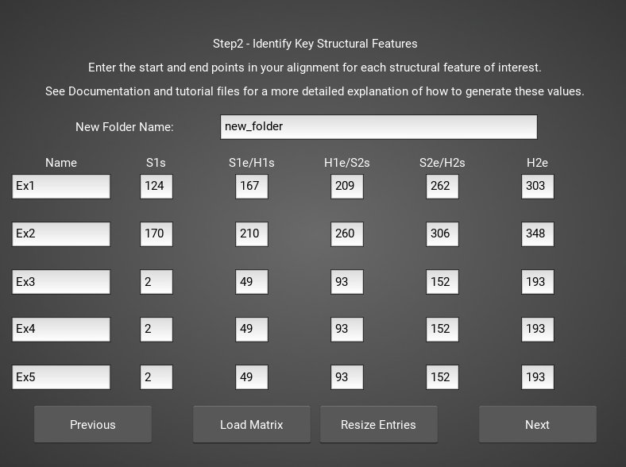
Step 2: Locate Helices and Strands
For this example, from mhc_testData load in ex_cd1d_hla_uda_uaa_ji.csv
So for FASTA1, Strand 1 starts (S1s) at position 124, Strand 1 ends (S1e) at pos 167, Helix 1 starts (H1s) at this same position. And so on...
Lastly, ”new_folder” is where output figures will be saved. Change this to whatever you want your folder name to be. Each run overwrites the figures, so maybe change to ”run1”, ”run2”, etc.
Notes:
Use this time to bring up the concepts of Shannon entropy and mutual information…
Talk just about the practical examples, but keep it in the space of amino acids.

Slide 28
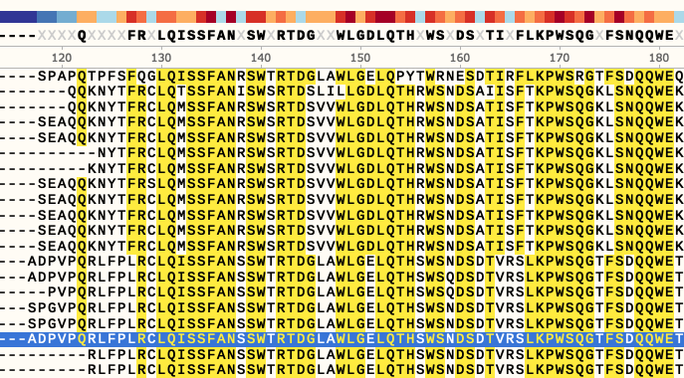
Step 2: Locate Helices and Strands
How do we locate helices and strands? NOTE, for this tutorial, this step has been done already
We first align molecules of interest within a single group
We then take a representative molecule (here human CD1d) and put it through our favorite structure prediction (Phyre, PsiPred, etc.)
When then go back and find where in the alignments a structural feature roughly begins
Here S1 starts at ”FPL” which occurs at alignment position 127. We add 3 amino acids of buffer space (optional, you can change this if you want) and you can see on the previous slide S1s = 124
Notes:
Use this time to bring up the concepts of Shannon entropy and mutual information…
Talk just about the practical examples, but keep it in the space of amino acids.

Slide 29
Step 2: Locate Helices and Strands
Already figured out locations of Helices/Strands (based on provided FASTA files):
For the ji_cartFish we have: 2,49,93,152,193
For the cd1d_seqs.fasta we have: 124,167,209,262,303
For the hlaA_seqs.fasta we have: 170,218,260,306,348
For cd1_ufa_genes.fasta: 22,66,105,158,199
For UAA or UDA fasta: 2,49,93,152,193
In the future, I hope to identify these helices and strands automatically within the software, but I haven’t found anything suitable yet for doing so
Notes:
Use this time to bring up the concepts of Shannon entropy and mutual information…
Talk just about the practical examples, but keep it in the space of amino acids.

Slide 30
Step 3: Generate the Sequence Matrix
On this window, you can just click “get matrix” to generate the matrix for this step
This matrix must be generated for subsequent steps to function properly
Notes:
Use this time to bring up the concepts of Shannon entropy and mutual information…
Talk just about the practical examples, but keep it in the space of amino acids.

Slide 31
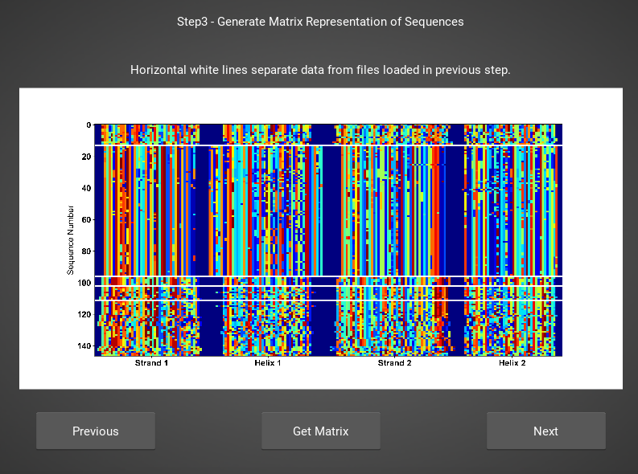
Step 3: Generate the Sequence Matrix
Congrats! You’ve generated your first piece of data using this software
You might notice that your image quality is poor for figures shown in the app
This is because the software shows *png files
Don’t worry, both versions of the plot are saved in whichever directory you specified in Step 2
Notes:
Use this time to bring up the concepts of Shannon entropy and mutual information…
Talk just about the practical examples, but keep it in the space of amino acids.

Slide 32
Step 4: Calculate Biophysical Properties
Again, we simply press the “get properties” button
If a matrix was not generated in the previous window, then this step will fail
Don’t worry if this step takes a little while, especially for bigger data. The code needs a little work, but is accurate
Notes:
Use this time to bring up the concepts of Shannon entropy and mutual information…
Talk just about the practical examples, but keep it in the space of amino acids.

Slide 33
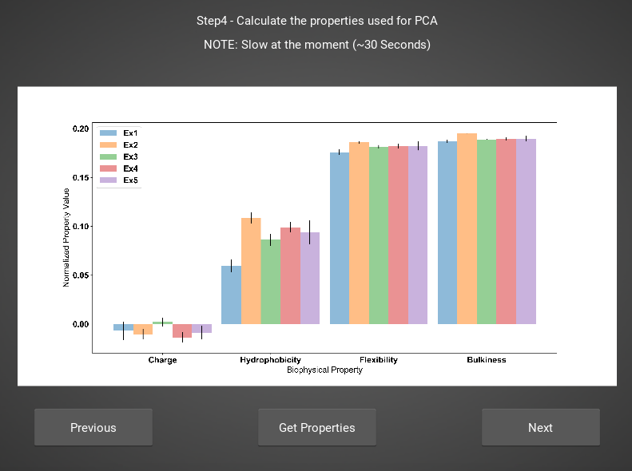
Step 4: Calculate Biophysical Properties
Again, if you’re following along, you should see this exact plot once the calculation finishes
Plotted are average and standard deviations of these normalized biophysical properties.
Each sequence has one value for each of these properties. i.e. cd1d_sequence1 has charge = -0.01, hydrophobicity = 0.05, etc. (values made up)
Notes:
Use this time to bring up the concepts of Shannon entropy and mutual information…
Talk just about the practical examples, but keep it in the space of amino acids.

Slide 34
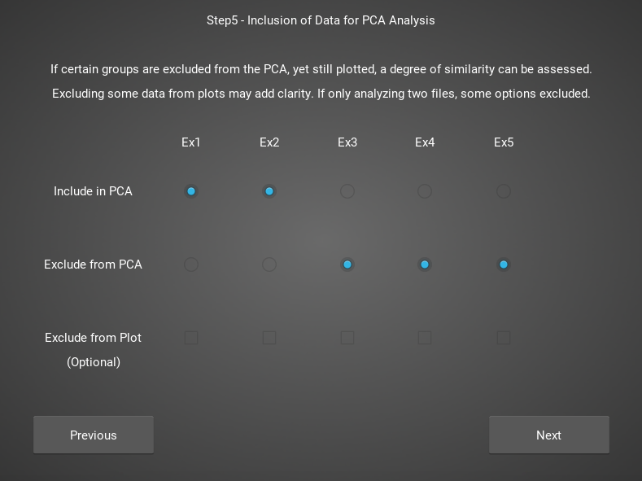
Step 5: Define Which Files to Group and Plot
In this step, you can really take some freedoms and play around.
What we are doing here is telling the software which groups we want to feed into the PCA analysis
Then, in the ”Plotted Group” section, we are letting the software know which groups will be shown on the resultant plot. Even if a group was used in the analysis, it doesn’t need to be plotted (and vice versa)
Notes:
Use this time to bring up the concepts of Shannon entropy and mutual information…
Talk just about the practical examples, but keep it in the space of amino acids.

Slide 35
Step 6: Run and Plot PCA
On this screen, we take the properties form step 4 and run a PCA on them
If you choose to exclude certain data from the PCA, but still plot it, then you are simply projecting that data onto the calculated principal component.
Notes:
Use this time to bring up the concepts of Shannon entropy and mutual information…
Talk just about the practical examples, but keep it in the space of amino acids.

Slide 36
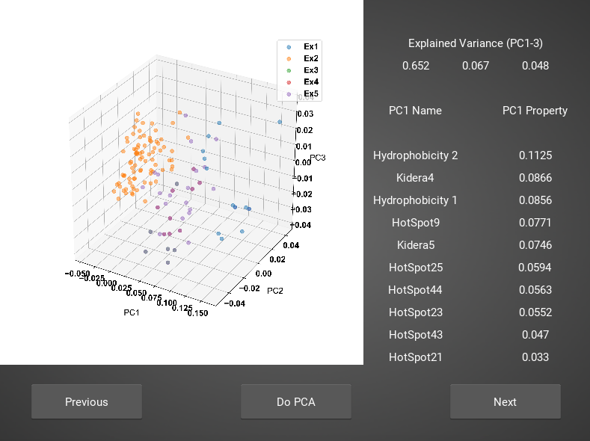
Step 6: Run and Plot PCA
Along with a plot of the first 3 PCs, we also report the explained variance of these PCs, and the top 10 weights that make up PC1.
A 2D plot is also included in the saved figures.
Notes:
Use this time to bring up the concepts of Shannon entropy and mutual information…
Talk just about the practical examples, but keep it in the space of amino acids.

Slide 37
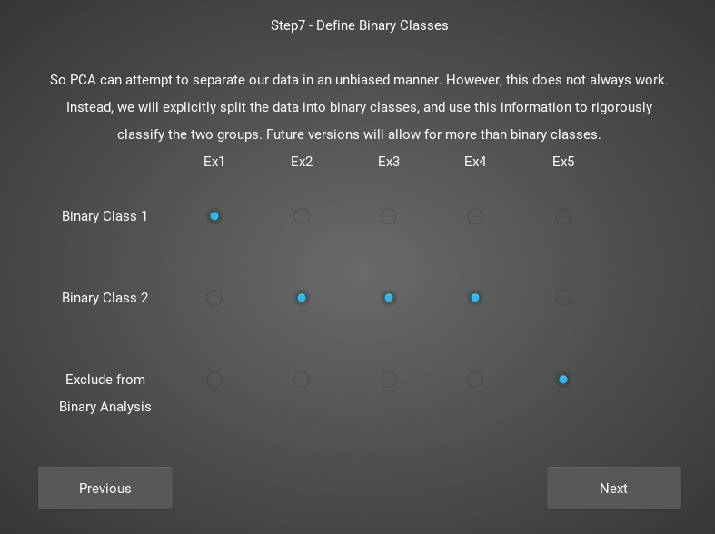
Step 7: Define Binary Classes
Here, we separate our loaded data into binary classes for some machine-learning based analysis.
Future versions will allow populations excluded from this analysis to still be plotted, as for PCA
Notes:
Use this time to bring up the concepts of Shannon entropy and mutual information…
Talk just about the practical examples, but keep it in the space of amino acids.

Slide 38
Step 8: Get Position Sensitive Biophysical Properties of Classes
Whereas the biophysical properties of step 4 are averaged across entire molecules, we can instead average across our full molecular population
By doing so, we can look at average biophysical properties as a function of sequence space, part of our special “positional encoding”
Notes:
Use this time to bring up the concepts of Shannon entropy and mutual information…
Talk just about the practical examples, but keep it in the space of amino acids.

Slide 39
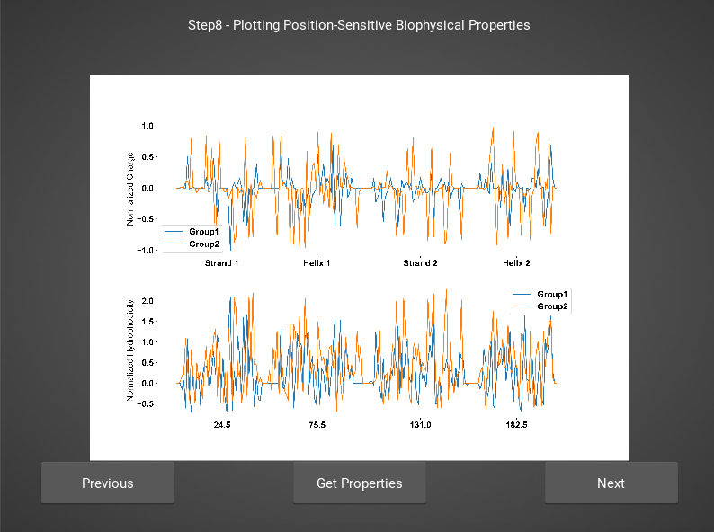
Step 8: Get Position Sensitive Biophysical Properties of Classes
We only show charge and hydrophobicity, but position sensitive data for all 62 properties are saved in the same directory as pdf figures.
NOTE: Standard deviations are not shown, and ideally these would be calculated via bootstrapping
There isn’t nearly as much variability in MHC sequences (at least those in this tutorial) so there is less smoothing of the properties
Notes:
Use this time to bring up the concepts of Shannon entropy and mutual information…
Talk just about the practical examples, but keep it in the space of amino acids.

Slide 40
Step 9: Linear Discriminant Analysis
Unlike PCA, linear discriminant analysis (LDA) is designed to split binary classes of data
Effectively, we can use it to find where the strongest differences in the data are
However, care must be taken not to overfit. If # Input Vectors is greater than the size of one of your datasets, you will overfit the data
Notes:
Use this time to bring up the concepts of Shannon entropy and mutual information…
Talk just about the practical examples, but keep it in the space of amino acids.

Slide 41
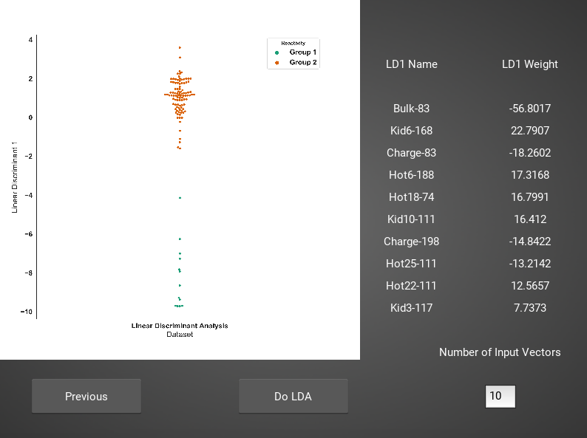
Step 9: Linear Discriminant Analysis
For this example data, if we use 10 input vectors, we obtain a decent splitting of the data
The LD1 “names” and “weights” refer to the top ten weights that most strongly split the data
In other words, LDA tells you where the biggest differences are, positionally, in your dataset
Notes:
Use this time to bring up the concepts of Shannon entropy and mutual information…
Talk just about the practical examples, but keep it in the space of amino acids.

Slide 42
Final Notes on Usage
Overall the software should be pretty flexible to different alignments, even non MHC-like molecules, as long as alignments are consistent and consist of four distinct regions.
Steps 3 and 6 can be re-run indefinitely, with inputs of Steps1/2 or Step5 being changed each time. In other words, you don’t need to start completely over each time you want to change parameters.
However, every time these steps are re-run, previously saved figures will be deleted. If you see something interesting in a certain configuration I recommend writing down the parameter settings used to generate that plot, then moving the resultant plots into another folder, with a naming convention that makes some intuitive sense.
Lastly, this software isn’t yet complete. New updates are in the process of being incorporated to make the GUI as comprehensive as the notebook. For instance, that stupid way of defining helices/strands will be critical for these future additions
Notes:
Use this time to bring up the concepts of Shannon entropy and mutual information…
Talk just about the practical examples, but keep it in the space of amino acids.

Slide 43
Known Bugs
So programming this wasn’t super easy, so there are certain issues I didn’t bother programming out. So just be careful
When you encounter these, the software will crash:
Not all entries in a row filled out on step 2. An entire row can be left blank, but no partial entries are allowed
Improper values in FASTA files. Currently the software only accepts amino acids and a “-” if you have “.”, “*”, or a space, the software will likely crash
This is potentially an issue that should be fixed, so please let me know if this is a glaring issue
Notes:
Use this time to bring up the concepts of Shannon entropy and mutual information…
Talk just about the practical examples, but keep it in the space of amino acids.

Slide 44
Thanks For Using This Software!
Notes:
VBPAAIM?... No

